Slide 1















Slide 2


AGENDA
Problem State
Solution With Code
Reporting
Conclusion

Slide 3

Problem State
The objective is to analyze the Kiva Loans dataset to identify factors that influence the success of loan funding.
This involves examining relationships between the funded amount and various attributes such as loan amount, sector, country, etc.
Through data cleaning, exploratory data analysis, and statistical modeling, we aim to uncover patterns and correlations that determine funding success.

Slide 4

Solution With Code
Notebooks:
Kiva Loan
Time Series

Slide 5
Solution With Code
Load and Explore Data:
Loaded dataset: loan = pd.read_csv('masked_kiva_loans.csv')
Displayed initial rows, shape, and info of the dataset.
Checked for duplicate records and duplicate IDs.
Identified the number of null cells in each column.
Provided summary statistics for numerical and categorical data.

Slide 6
Solution With Code
Data Preprocessing:
Filled missing values in 'partner_id'.
Analyzed and filled missing values in 'borrower_genders' with the mode.
Created new features: 'borrower_gender_male_count' and 'borrower_gender_female_count' by counting occurrences in 'borrower_genders’.
Check negative in numeric columns.

Slide 7
Solution With Code
Data Visualization:
Boxplots for numerical variables: 'funded_amount', 'loan_amount’.
Histograms: 'funded_amount', 'loan_amount’.
Pie chart for 'repayment_interval' distribution.
Countplot for 'sector' distribution.
Time series plot for 'funded_amount' by quarter.

Slide 8
Solution With Code
Correlation Analysis:
Calculated correlation between 'funded_amount' and 'lender_count’.
Calculate & Visualize correlation matrix and top 10 features correlated with 'funded_amount’.

Slide 9
Solution With Code
Linear Regression & Decision Tree Modeling:
Linear Regression with Top Correlated Features.
Linear Regression with SelectKBest Features (K=10).
Decision Tree Regression (max_depth=10) with SelectKBest Features(K=10).
After evaluation Decision Tree Regression is considered the best model.

Slide 10
Solution With Code
Time Series:
Selected relevant columns: 'funded_amount' and 'date’.
Converted 'date' column to datetime format.
Grouped data by date and aggregated the funded amount.
Stationarized the series using rolling mean and standard deviation.
Conducted the Dickey-Fuller test for stationarity.

Slide 11
Solution With Code
ARIMA Model:
Split the data into training and testing sets.
Utilized ARIMA model.
Fitted the ARIMA model on the training data and made predictions.
Evaluated model performance using R-squared (R²) value.
Forecasted future values using the trained ARIMA model.

Slide 12
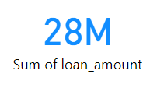
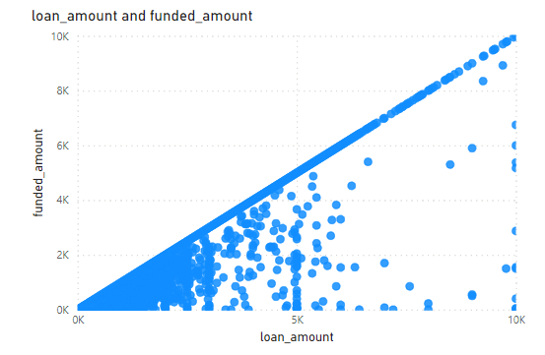
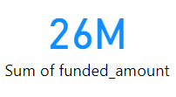
Reporting
Correlation between Loan_Amount and Funded_Amount
Notes:
We found that the Loan requested is almost the same as the Funded one.

Slide 13
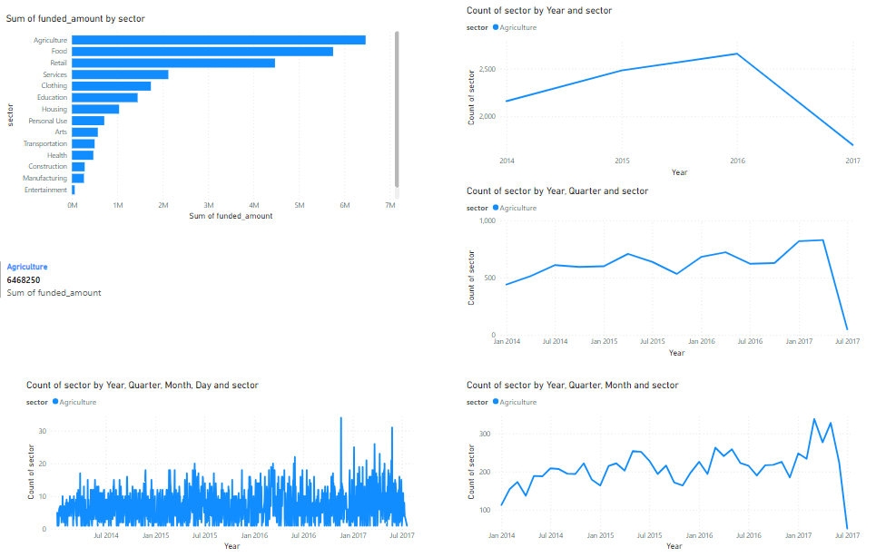
Reporting
Which sectors receive the highest amount of funding?
How does this change over time?
Notes:
Agriculture.

Slide 14
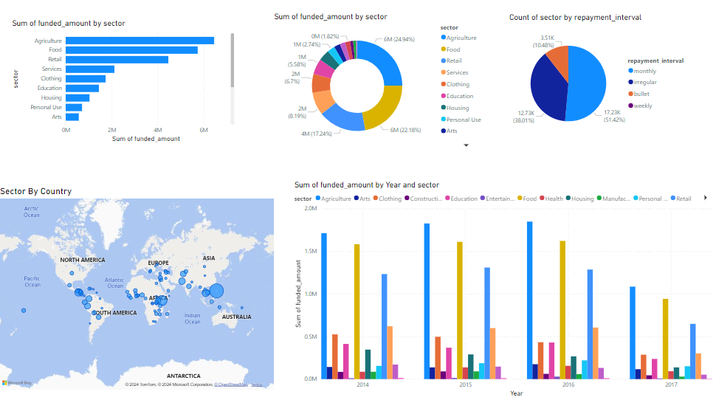
Reporting
Which sectors receive the highest amount of funding?
How does this change over time?

Slide 15
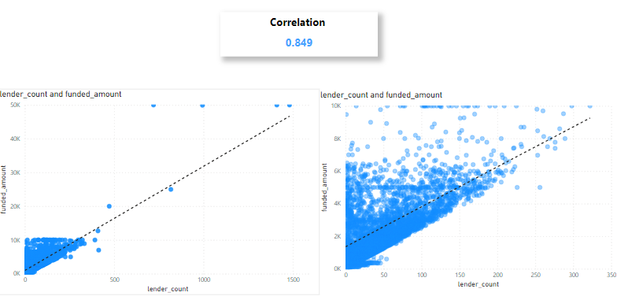
Reporting
Is there a correlation between the Lender_Count and Funded_Amount?
Notes:
Positive Correlation.

Slide 16
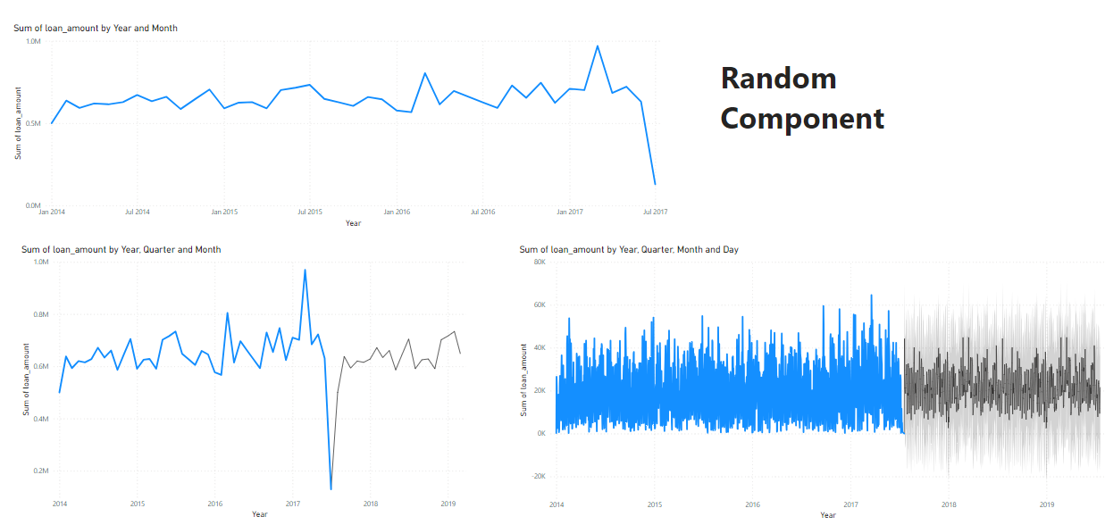
Reporting
Can we predict future loan amounts based on historical data?
Notes:
Random Component.

Slide 17
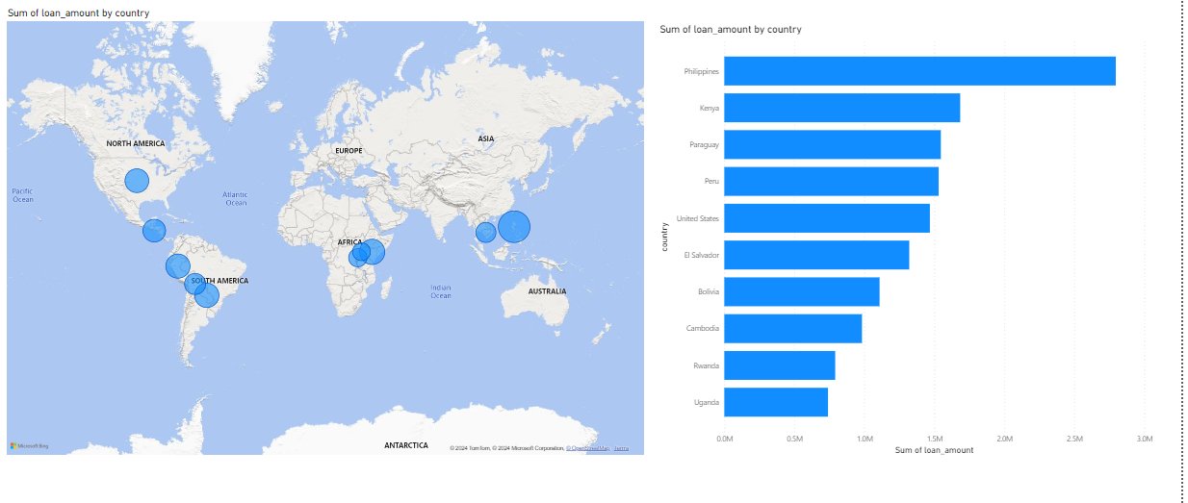
Reporting
Top 10 Countries With Highest Loan_Amount?

Slide 18
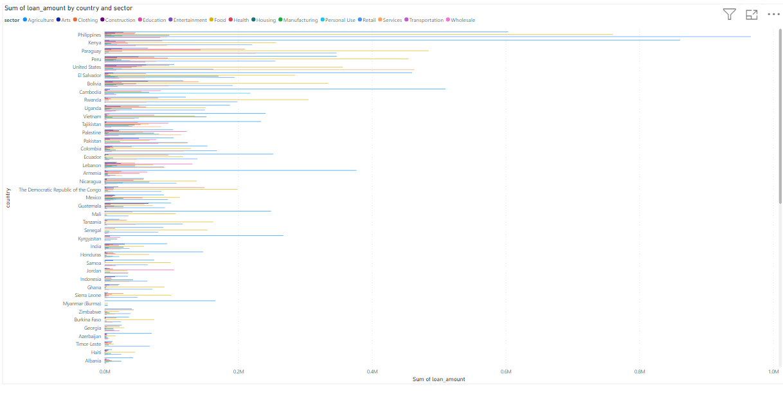
Reporting

Slide 19
Conclusion
Here are the key insights in bullet points:
Almost all loan requests have been successfully funded.
The Agriculture Sector consistently has the highest loan funding.
That has remained stable over time.
There is no Seasonality or Trending Component.
Only Random Component in 2017.
No correlation exists between the highest funded Sectors and the top
Countries with the highest loan funding.
There is a positive correlation between the number of lenders and the amount funded.

Slide 20
Thank you

